Slide 1
Evaluating Artificial Neural Networks and Traditional Approaches for Risk Analysis in Software Project Management - A case study with PERIL dataset
Carlos H. M. S. Timoteo, Meuser J. S. Valenca and Sergio M. M. Fernandes
Computer Engineering Department University of Pernambuco

Slide 2

Risk... What? Why?

Slide 3
Motivation
Many software development projects end in failure.
25% are canceled outright and as many as 80% run over their budget, exceeding it by 50% in average.
Industry surveys suggest that only 1/4 of software projects succeed outright, and billions of dollars are lost annually.

Slide 4
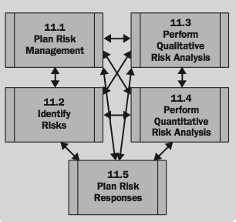
Project Risk Management

Slide 5
PERIL Dataset
Kendrick (Kendrick, 2003) have collected 649 anonymous risk registers from project leaders dealing with their past project problems.
Categorized as scope, schedule and resource and subclasses.

Slide 6
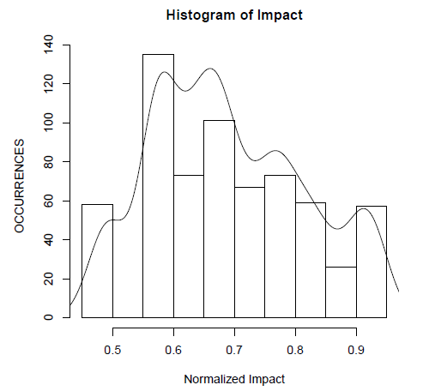
Data Preprocessing
Binarization, normalization, selection of better variables, split-sample cross-validation method.

Slide 7
Experiment
Setting standard method: MLRM or RTM;
Compare MLRM, MCS,MLP and SVM;

Slide 8
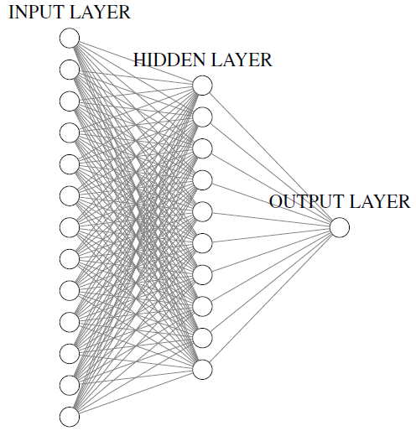
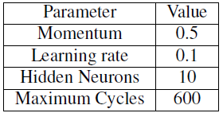
Experiment Setup

Slide 9
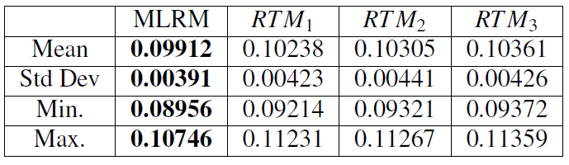
Results

Slide 10
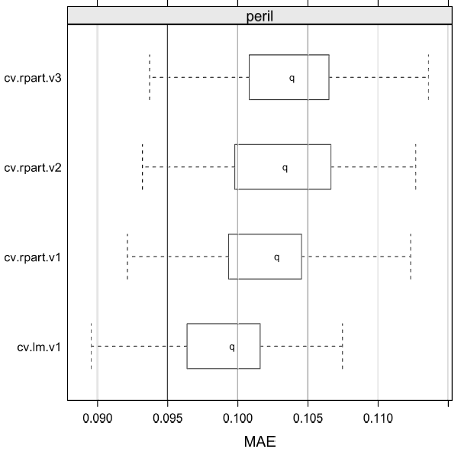
Results

Slide 11
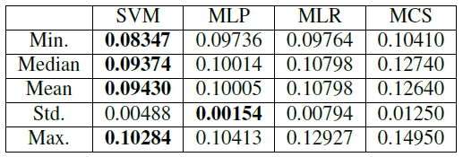
Results

Slide 12
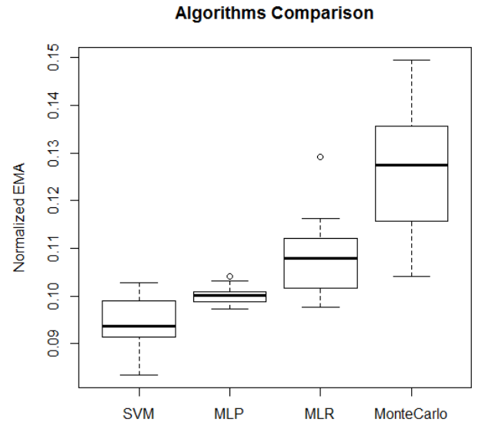
Results

Slide 13
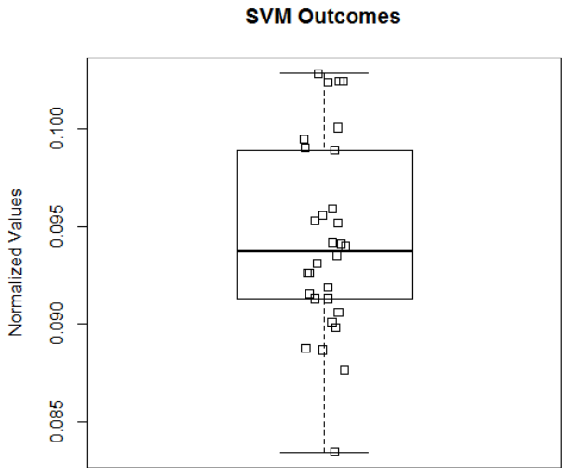
Results

Slide 14
Conclusions
MLP had minor standard deviation estimation error, and showed to be a promissory technique;
SVM had minor estimation error outcomes, which is a more accurate method.

Slide 15
Conclusions
MLP had minor standard deviation estimation error, and showed to be a promissory technique;
SVM had minor estimation error outcomes, which is a more accurate method.

Slide 16
Awesome! But, why people do not use ANN approaches in real projects to risk impact estimate? Do they need risk management?

Slide 17
Future Works
Analyze another ANN models and learning methods;
Compare selected ANN models with PERT, Monte Carlo Simulation, Neuro-Fuzzy Models;
Perform a case study with an company risk database to validate findings.

